Slide 1

LIBRARY MANAGEMENT SYSTEM
Contributed by:
Aman kshetri - 21003
Tej Mahesh – 21041
Priyanshu aggARWAL-21050
Raj sah rauniyar-21051
Saroj kumar bhagat-21060

Slide 2
Abstract
The Library Management system (LMS) acts as a tool to transform traditional libraries into digital libraries.
The LMS is designed with the basic features such as librarian can add/view/update/delete books and students' details in it.
The complete model is developed in Python language. Tkinter is used to build the front end application whereas the SQL server is exploiting as database.
Thus our system contributes its new approach towards the digital library setup.

Slide 3
Introduction
A Library management system (LMS) is software that is designed to manage all the functions of a library. It helps librarian to maintain the database of new books and the books that are borrowed by members along with their due dates.
This system completely automates all your library’s activities. The best way to maintain, organize, and handle countless books systematically is to implement a library management system software.
A library management system is used to maintain library records. It tracks the records of the number of books in the library, how many books are issued, or how many books have been returned or renewed or late fine charges, etc.
The purpose of a library management system is to provide instant and accurate data regarding any type of book, thereby saving a lot of time and effort.

Slide 4
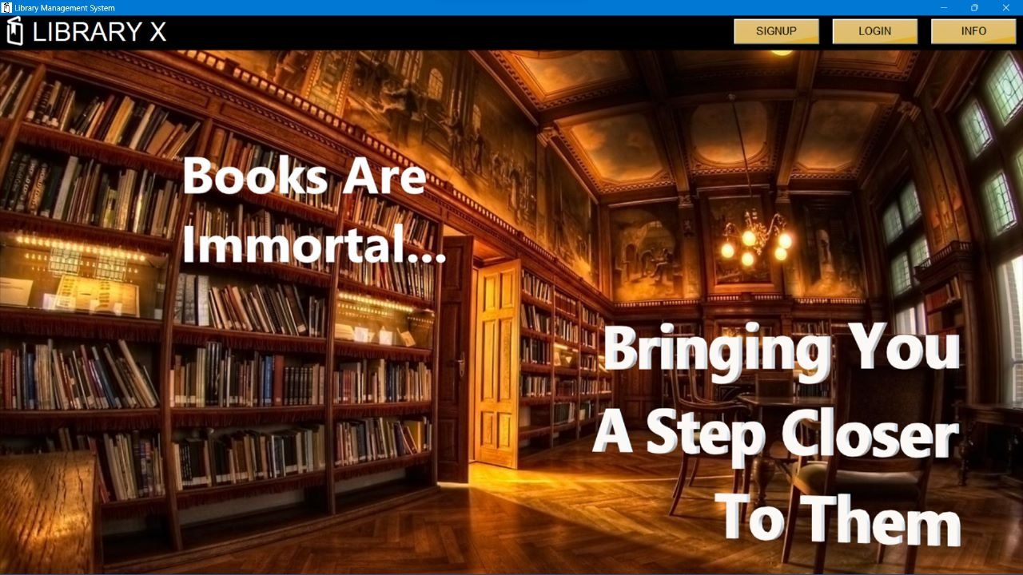
LANDING PAGE
Landing Page of Library Management System. It consists of Login, Signup and Info.

Slide 5
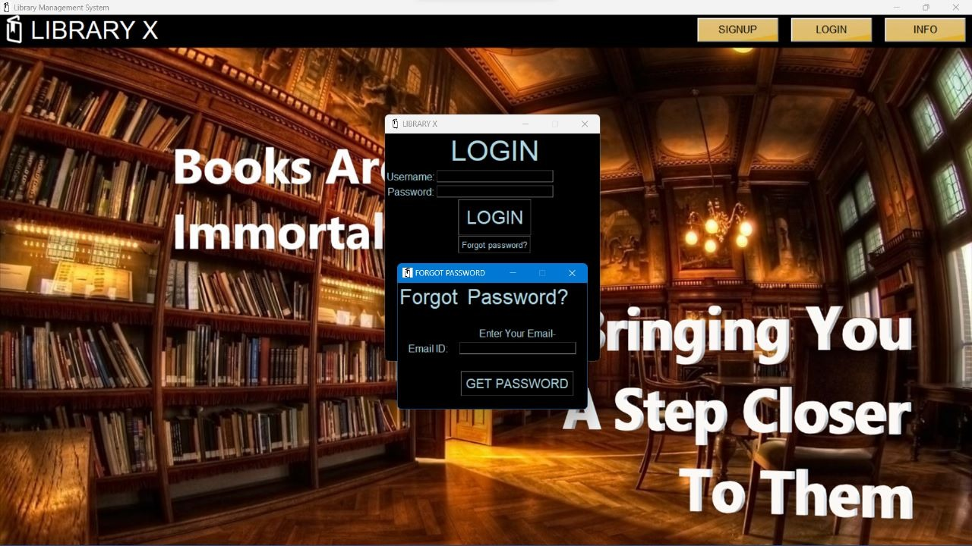
LOGIN
User will enter into the library system by giving his credentials and if the user forgets password user can reset the password by giving mail id.

Slide 6
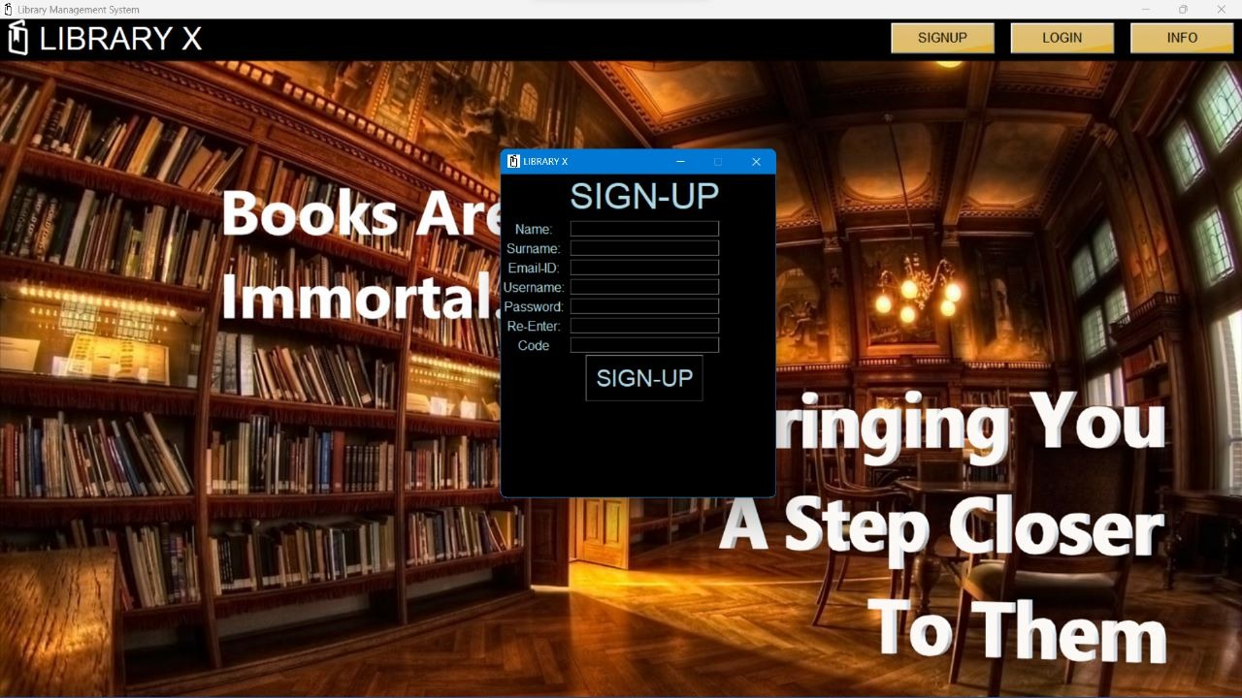
SIGNUP
User will fill the necessary details for registering into the system

Slide 7
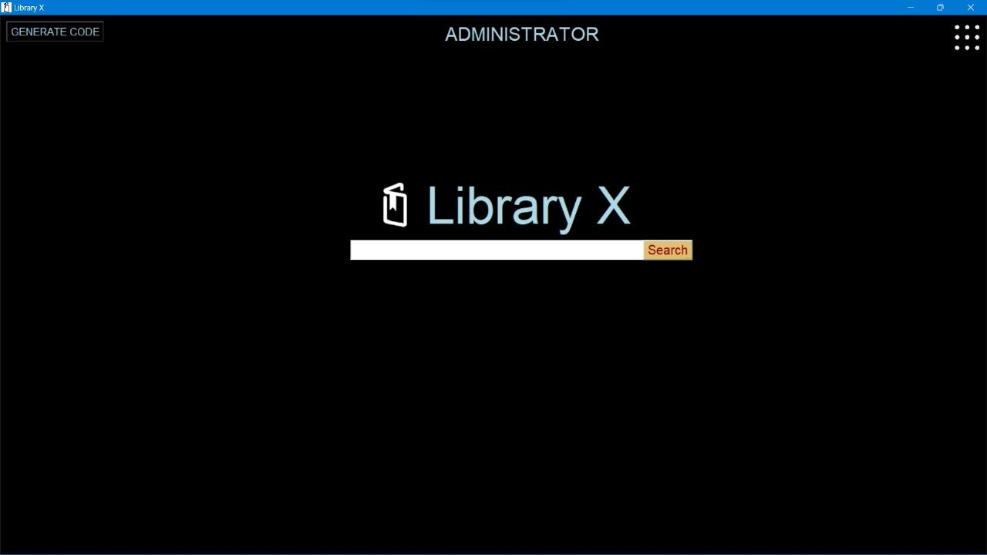
ADMIN
Has access to library system and generates unique passcode to the users and has many librarians working under him.

Slide 8
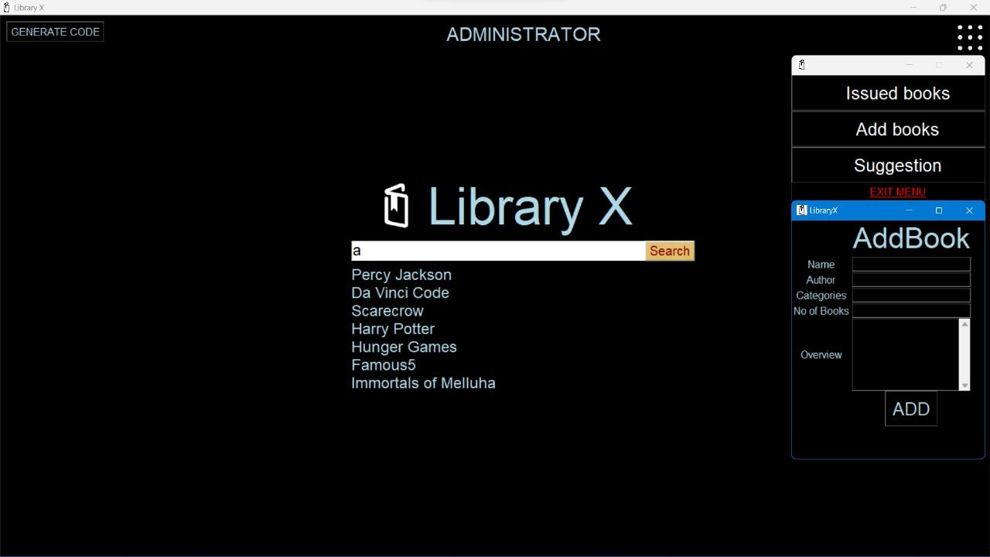
LIST OF BOOKS
A certain collection of available books will be displayed on the system after logging in admin can search for books and can add books by the request of users and can see the issued ones.

Slide 9
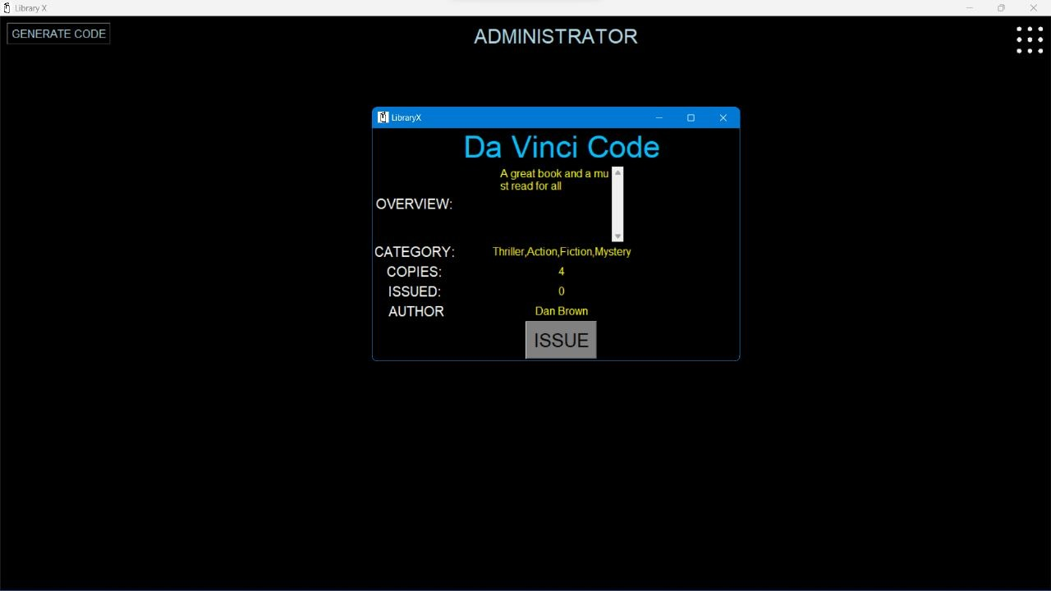
BOOK ISSUING
Once the amount is paid by the user librarian will issue the book with submission date for the book

Slide 10
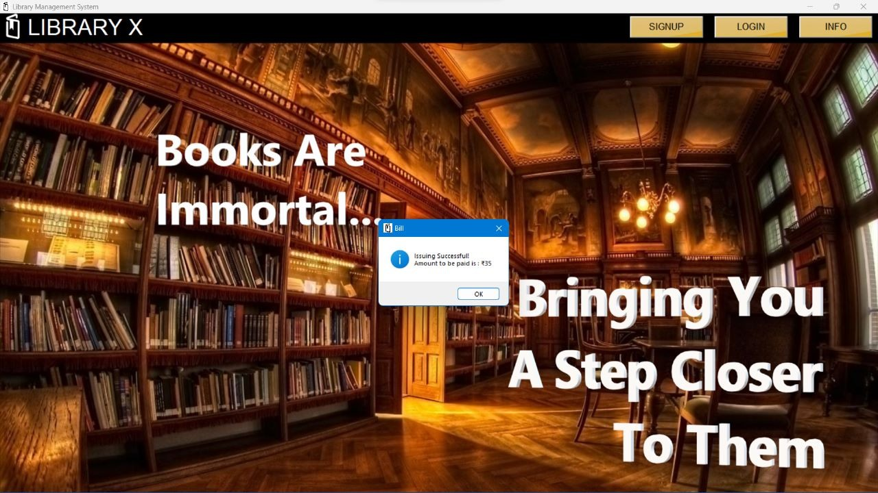
ISSUED BOOKS BILL
Once the user borrowed a book for a stipulated amount of time user have to pay some amount for issuing.

Slide 11
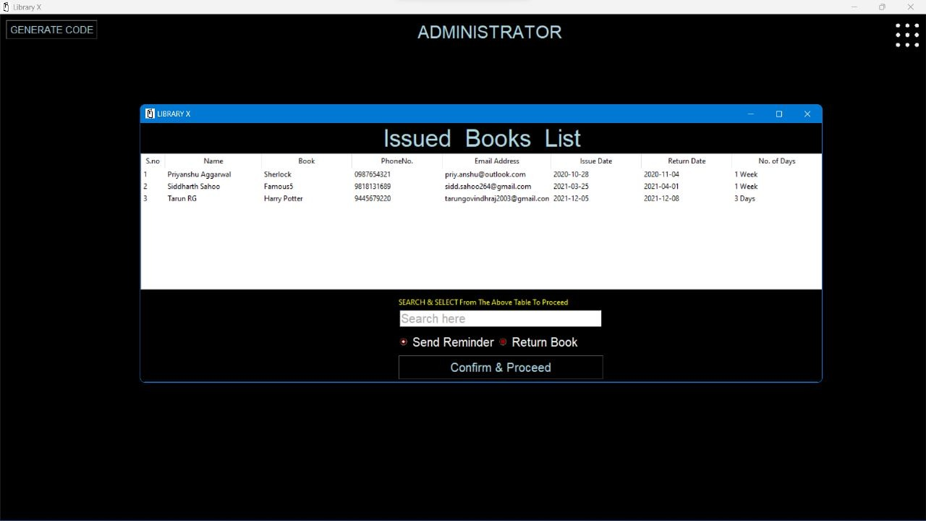
ISSUED BOOKS LIST
Admin can see the issued books list and its details of the user, issue date and return date. Admin can also send reminder to the users if the submission date is approaching.

Slide 12
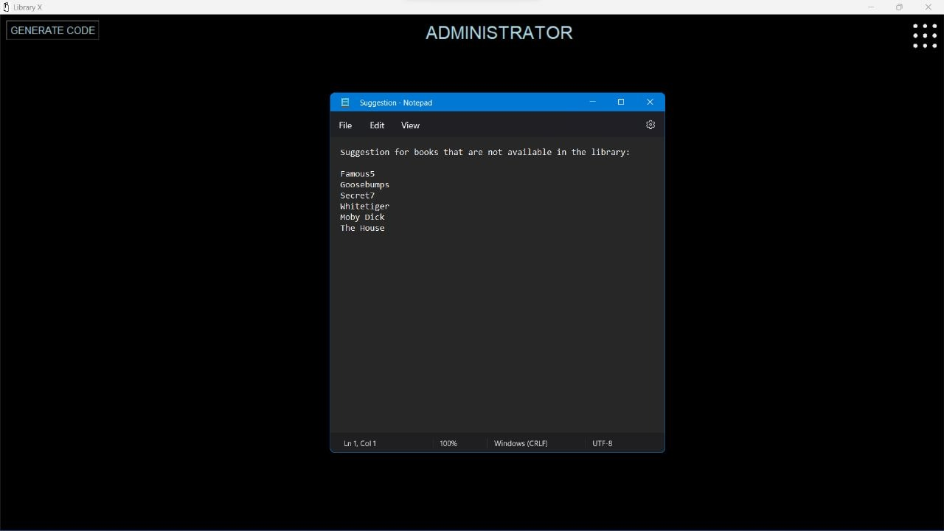
SUGGESTIONS
User can give requests to add books based on his preference.

Slide 13
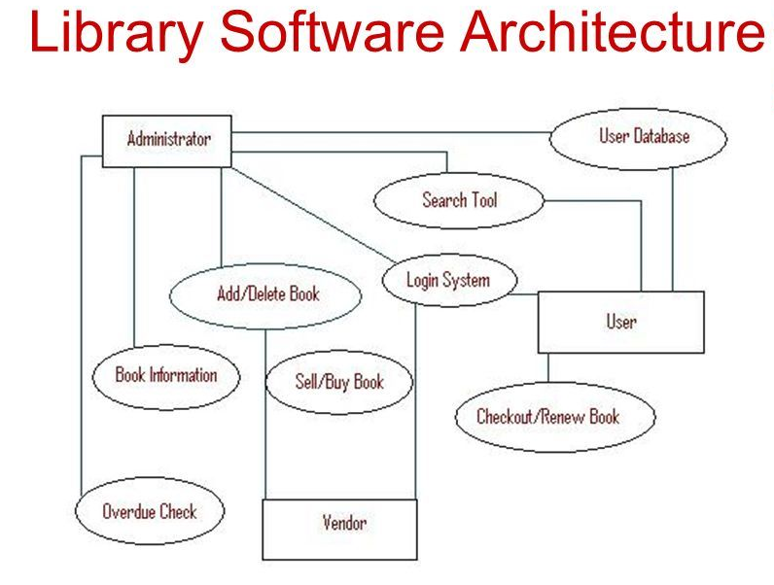
Architecture Diagram

Slide 14
Conclusion and Result
The Library Management System is much more user-friendly, faster in operation and easy to manage than the manual one. Through the use of it, the librarian can manage the whole data of the library in a single database in different tables with a much more security than the traditional way.

